Slide 1
Evelander
Let’s celebrate the events

Slide 2
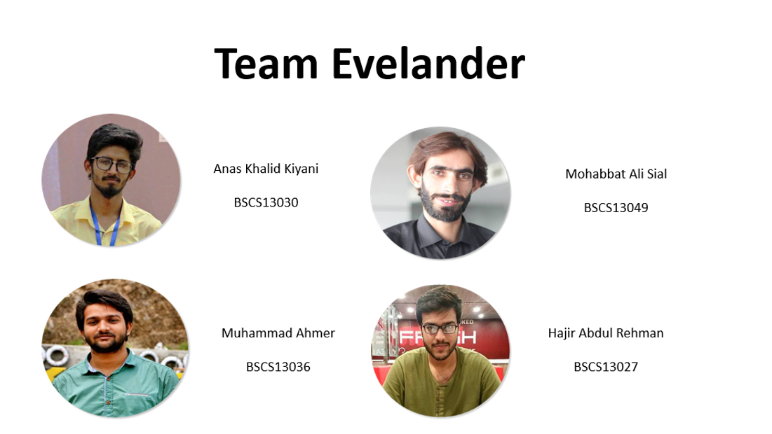

Slide 3
Problem
Targeted audience were the organizers and the attendees
Problems they were facing:
  Missing the event
  Didn’t get informed about the event
  Didn’t get notified about the event
  Attendees were less than the estimation or the security checks.

Slide 4
POV’s of the Organizers and Attendees
Kabeer Afzal Khan (Head Barsalego, FAST FSD)
Facebook is a liar and there isn’t any platform for publically announcing the event.
Ahmad Islam (Program Manager, Plan9)
Infrequent Facebook users but interested person may missed the specific events.
Zeeshan Mirza (Software Engineer, PITB)
Security is the major issue.
Zohaib Qureshi (Attendee)
Cancellation of an event is not annoying unless you get notified earlier.

Slide 5
3 Best HMW’s
The best of these HMW we choose are,
HMW ensure the maximum number of attendees
HMW target infrequent users of Facebook
HMW let the attendees know about the update in the schedule or cancellation of the event.
Best Solution
Mobile application that solves all the problems of both organizers and attendees

Slide 6
About Evelander
Evelander is a multi-purpose app that will allow you to locate all the events happening near you.
There will be different categories like sports, textile, media, arts, expos, travel, etc. You can select multiple categories of your interest.
You can add any of those events in your favourites or going list.
The events will have a short description, includes timing, date, day and venue.
A short reminder will appear on the day of the event or as you want.

Slide 7
About Evelander
Cancellation / update of an event
Rate any event
provide your valuable reviews
  help the organizers to improve their events and remove their flaws.

Slide 8
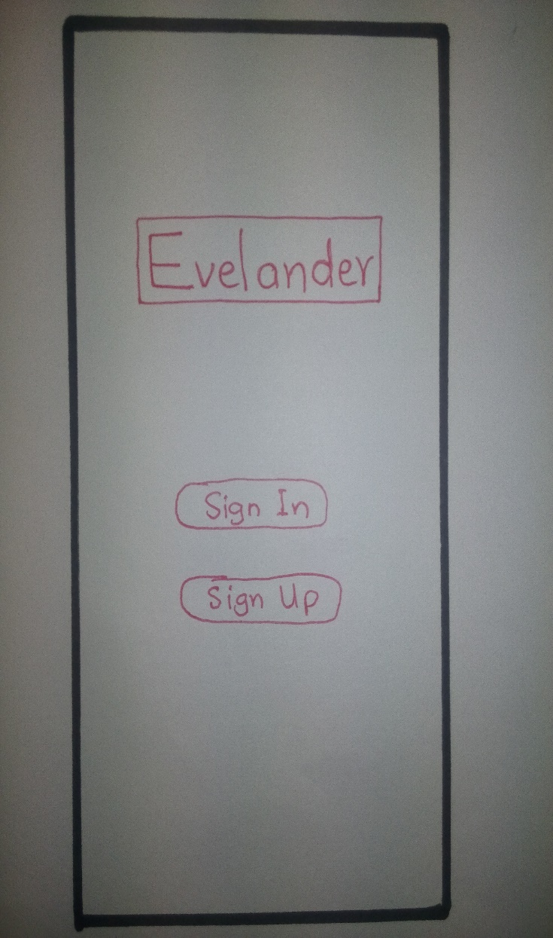
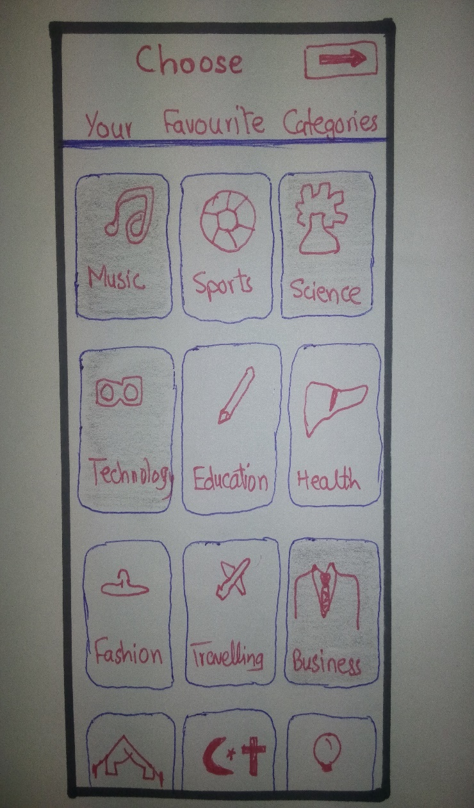
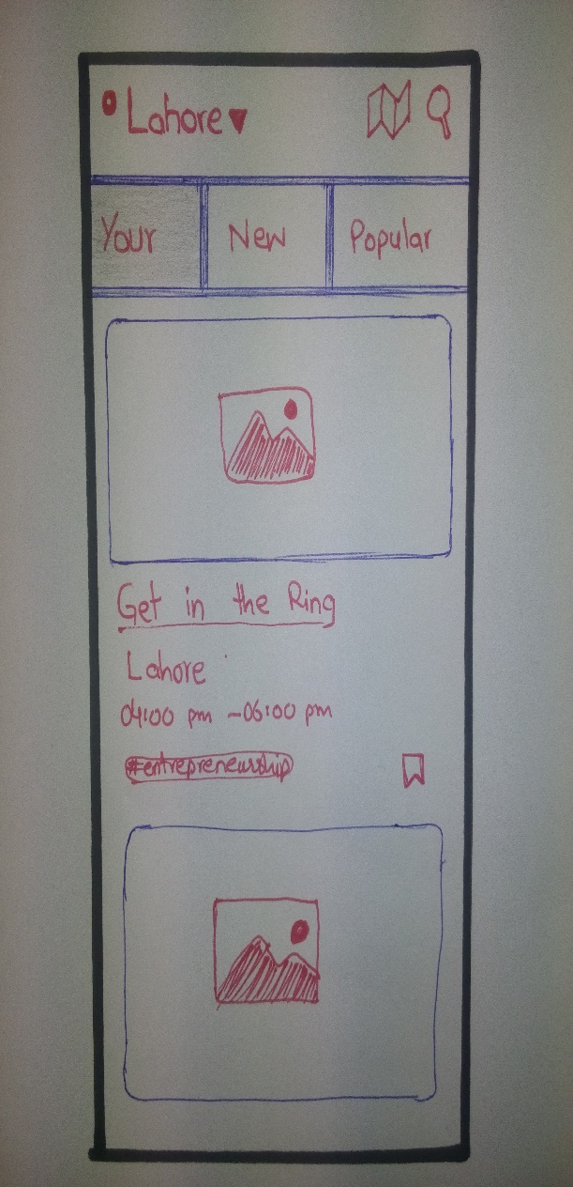
Low-fi Prototype

Slide 9
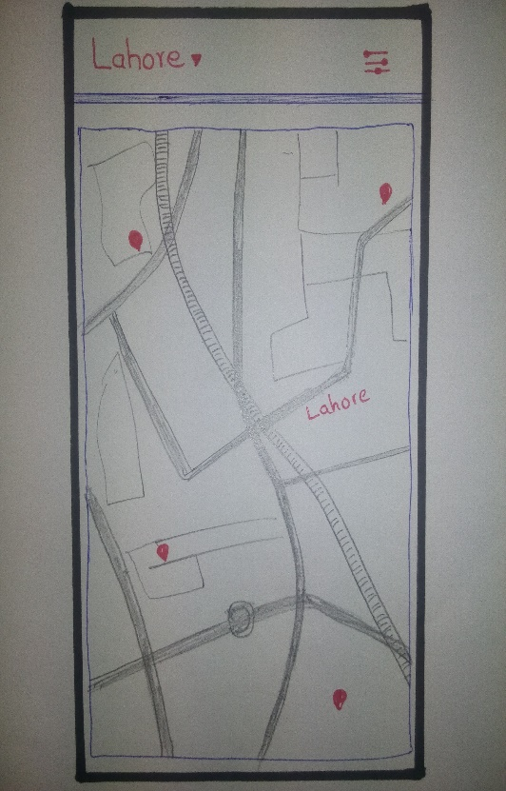
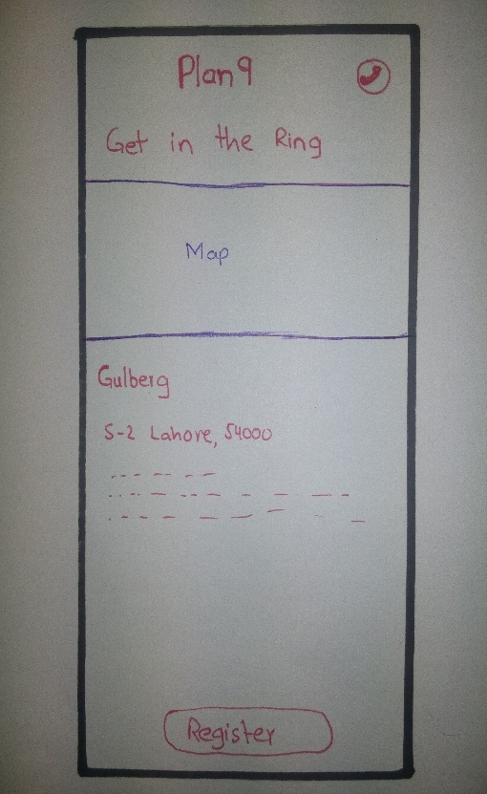
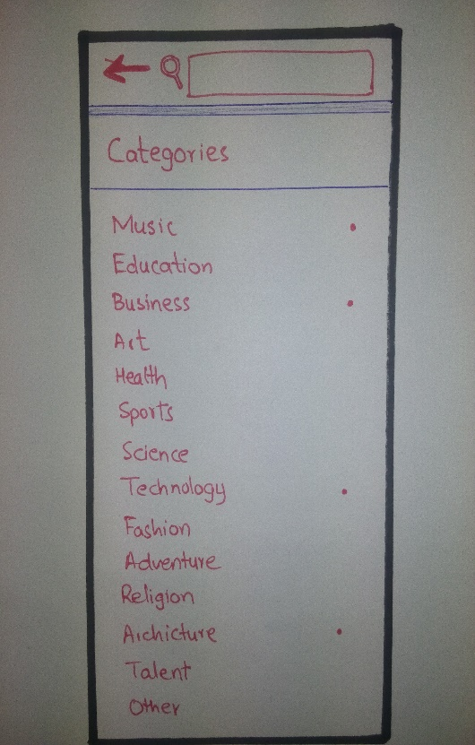
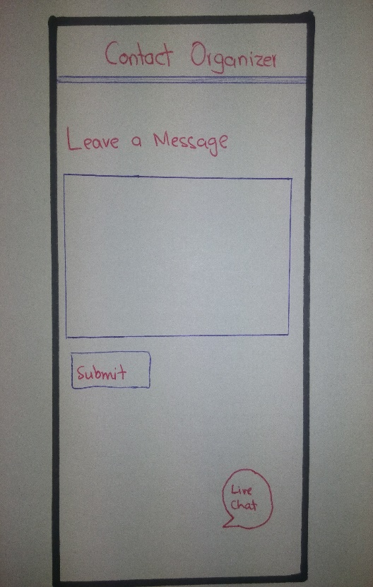

Slide 10
Medium-fi Prototype
https://projects.invisionapp.com/d/main#/console/11157909/236094576/preview

Slide 11
Testing
Task Measures
  Understanding of interface of an application
  Waiting of a person for looking for specific option
  Unexpected and Expected Clicks

Slide 12
Thank you..!
Questions?

